Slide 1
Infant Mortality Rate
This presentation is about mortality rate among children. I’ve used UN website to extract the data. All the plots have been generated by tableau. I will define the mortality rate and show you some meaningful trends with some potential reason for those trends.
The UN website (http://data.un.org/)

Slide 2
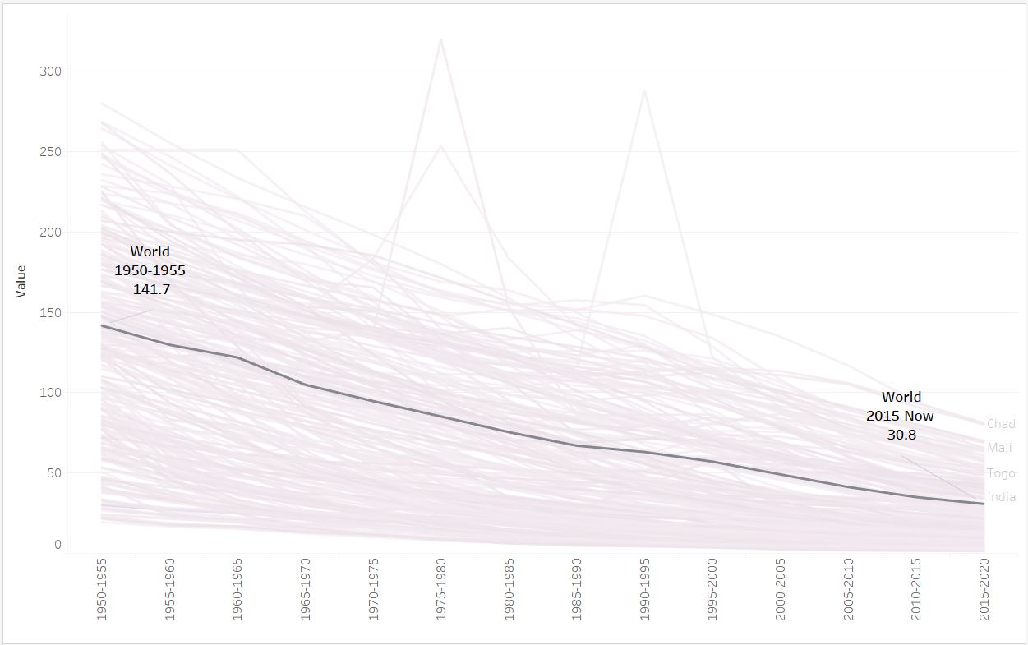
Infant mortality rate, for both genders combined (infant deaths per 1,000 live births) in the world 1950-2018
Infant mortality rate is defined as the number of deaths among children under one year per 1000 live births. My trend analysis was conducted among 241 countries over the course of last 68 years. This analysis shows a slight decrease of global mortality rate mainly caused by improved education and health conditions particularly among poor countries.

Slide 3
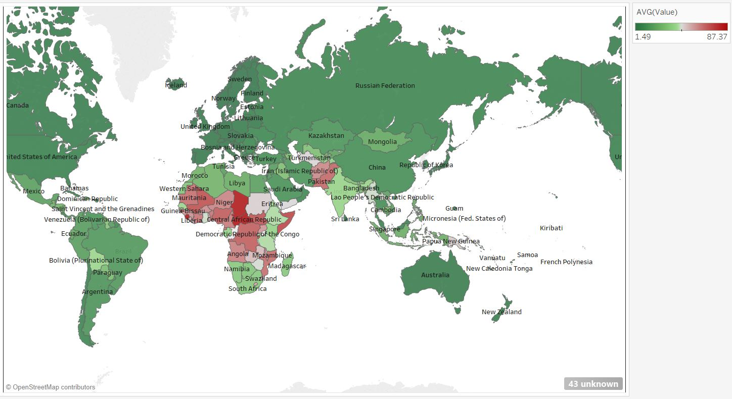
Infant mortality rate (deaths/1,000 live births) 2010-2018
Here I’m showing a map of infant mortality rate for all the countries in the world. The red color shows the countries with higher rate of mortality. As we can see the continent of Africa having the highest infant mortality rate than any other region with over 68 deaths per 1,000 births in ten years.

Slide 4
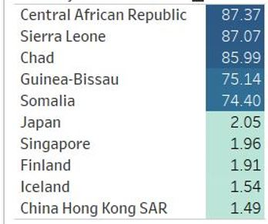
The top and bottom five countries (2015-2018).
The five countries with the highest and lowest mortality rates in the recent decade are shown below.

Slide 5
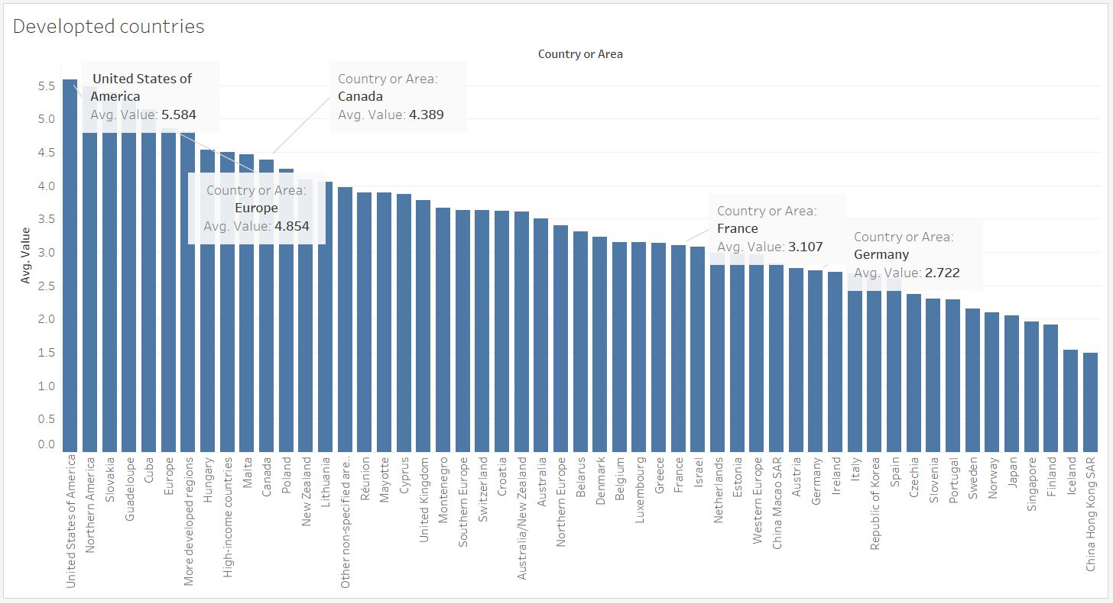
Mortality rate among developed countries (2015-2018).
The United States has the highest Infant Mortality Rate among the most developed countries despite greater spending on health care.

